Slide 2
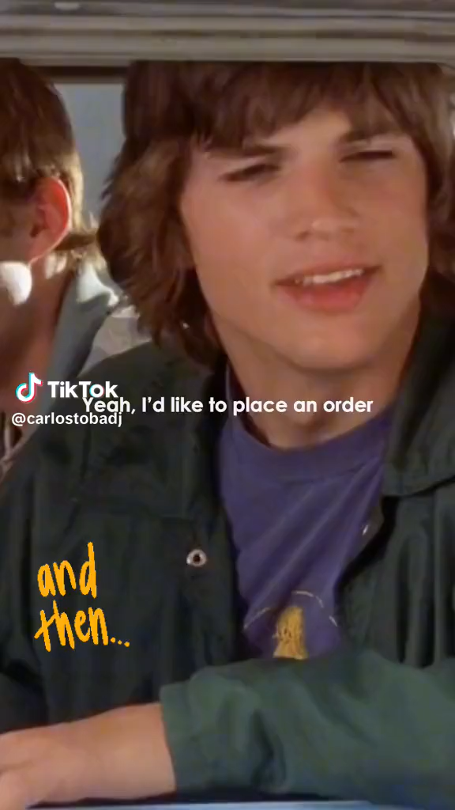

Slide 3
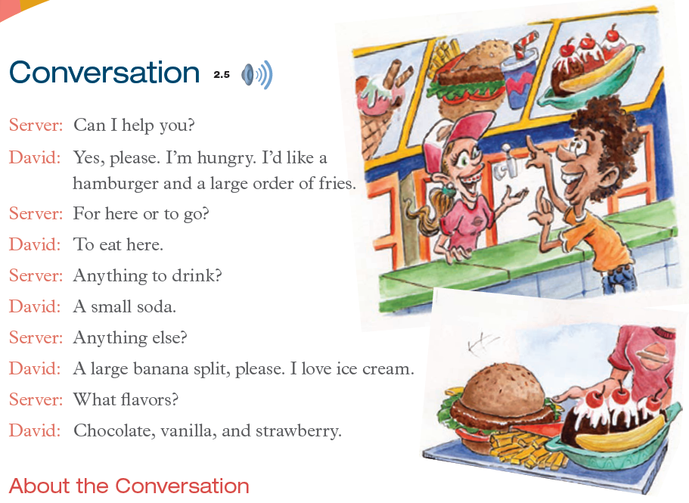

Slide 4

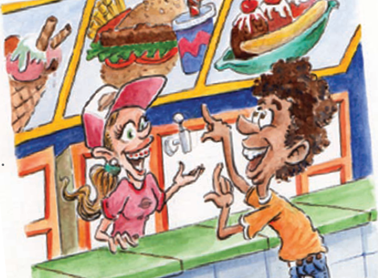
Server: Can I help you?
David: Yes, please. I’m hungry. I’d like a hamburger and a large order of fries.

Slide 5
Server: Can I help you?
David: Yes, please. I’m hungry. I’d like a hamburger and a large order of fries.

Slide 6
Server: For here or to go?
David: To eat here.

Slide 7
Server: For here or to go?
David: To eat here.

Slide 8
Server: Anything to drink?
David: A small soda.

Slide 9
Server: Anything to drinks?
David: A small soda.

Slide 10
Server: Anything else?
David: A large banana split, please.
I love ice cream.

Slide 11
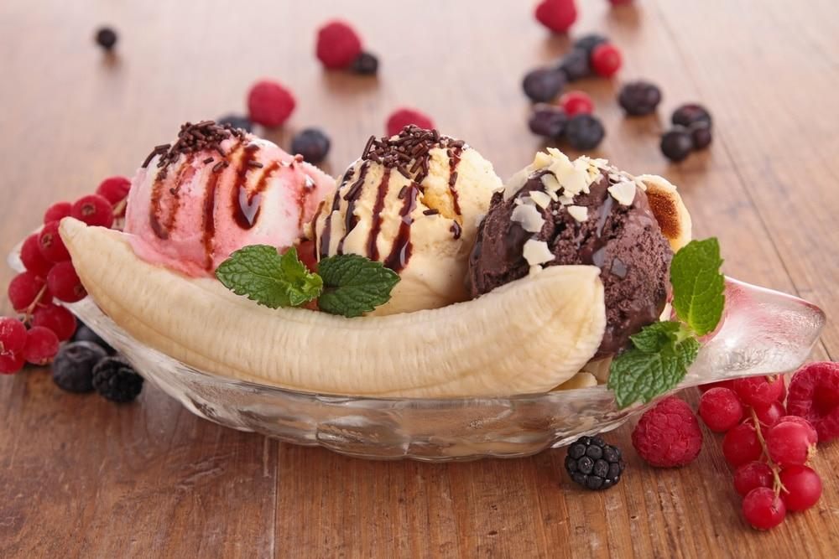
Server: Anything else?
David: A large banana split, please.
I love ice cream.

Slide 12
Server: What flavors?
David: Chocolate, vanilla, and strawberry.

Slide 13
Server: What flavors?
David: Chocolate, vanilla, and strawberry.

Slide 14
Music Ball

Slide 15

Person on the left
Person on the right
yourself
Person on the left
Person on the right
yourself
Person on the left
Person on the right
yourself
Person on the left
Person on the right
yourself
Person on the left
Person on the right
yourself
Person on the left
Person on the right
yourself
Person on the left
Person on the right
yourself
Person on the left
Person on the right
yourself
Person on the left
Person on the right
yourself
Person on the left
Person on the right
yourself
Person on the left
Person on the right
yourself
Person on the left
Person on the right
Say STOP!
yourself
Read 1 sentence
Read 2 sentences
Read 3 sentences
Read 1 sentence
Read 2 sentences
Read 3 sentences
Read 1 sentence
Read 2 sentences
Read 3 sentences
Read 1 sentence
Read 2 sentences
Read 3 sentences
Read 1 sentence
Read 2 sentences
Read 3 sentences
Read 1 sentence
Read 2 sentences
Read 3 sentences
Read 1 sentence
Read 2 sentences
Read 3 sentences
Read 1 sentence
Read 2 sentences
Read 3 sentences
Read 1 sentence
Read 2 sentences
Read 3 sentences
Read 1 sentence
Read 2 sentences
Read 3 sentences
Read 1 sentence
Read 2 sentences
Read 3 sentences
Read 1 sentence
Read 2 sentences
Read 3 sentences

